Slide 1

High‐level source code overview
Aniket Aranake
Department of Aeronautics and Astronautics, Stanford University

Slide 2
Goal of this talk:
To describe the algorithms implemented in SU2_CFD.

Slide 3
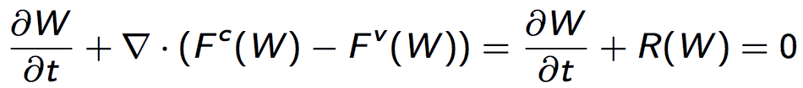
Governing Equations
Navier-Stokes Equations
At each iteration the solver will
  Compute R(W)
  Compute an update to W to drive R(W) → 0
Residual
Conservative variables
Convective Fluxes
Viscous Fluxes

Slide 4
The big picture
Initial guess for solution
(Typically uniform flow)
Evaluate R(W)
i.e. Compute convective
and viscous fluxes
Update W
W ^{n+1} = W ^{n} + ΔW
R(W)=0?
No
Yes
Stop

Slide 5
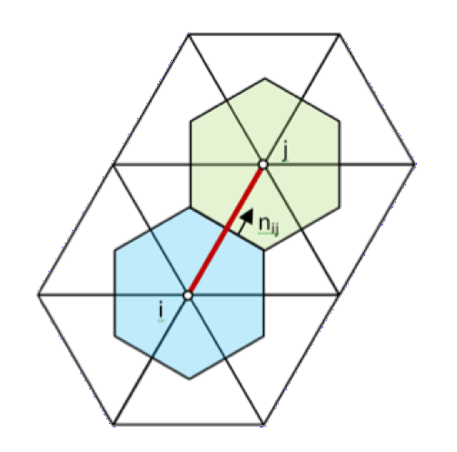
Primal vs dual grids
Primal Grid – Defined
by mesh (user input)
Dual Grid – Computed
by SU2. These are the
“Finite volumes”

Slide 6
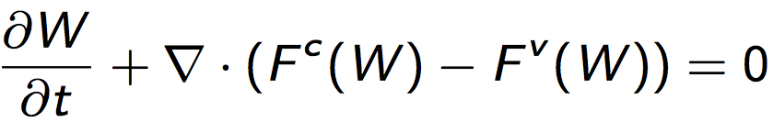
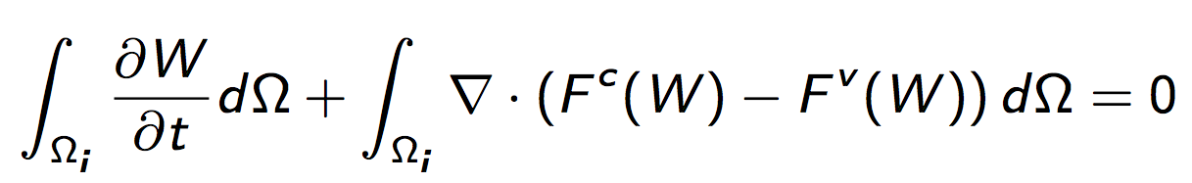
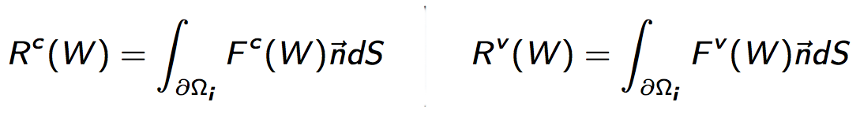
Finite Volume Method
(Navier-Stokes)
Integrate over a finite volume Ωi
Apply Green-Gauss theorem to convert
to boundary integrals

Slide 7
More geometry vocabulary
Face – Face of finite volumes. These are the boundaries where the integrals are computed.
(Area in 3D)
Primal Grid – Defined
by mesh (user input)
Dual Grid – Computed
by SU2. These are the
“Finite volumes”
Edge – Segment connecting two points of primal grid. The code loops over edges when computing fluxes.
(Line segment in 3D)
Vertexes of primal grid – Solution
data is stored at these locations

Slide 8
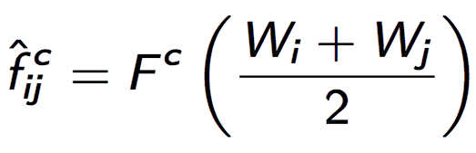

Computing convective flux
Solution data stored at points i and j
Flux needed at face
What can we try?
  Average solution, then compute flux:
  Compute flux at i and j, then average
Unfortunately, these simple ideas don't work for convection!
face

Slide 9
Computing convective flux
Additional desirable properties for a scheme:
  Stable
  Upwinding
  Capture shocks
  Low dissipation in smooth regions
  Higher-order accuracy
SU2 implements:
  JST
  Roe
  HLLC
  AUSM
  See paper for more info!
face
2nd order accurate
using MUSCL

Slide 10
Viscous fluxes
Strategy similar to convective fluxes, but gradients ∇W required
How to compute gradients?
  Green-Gauss
  Weighted Least Squares
This gives gradients at each point i and j.
  What about the face between points i and j?

Slide 11
Viscous fluxes
“Pure” Average Gradient:
  1st order accurate due to cancellation errors
Corrected Average Gradient:
  Replace component of gradient parallel to ij with finite difference
  2nd order accurate
Face

Slide 12
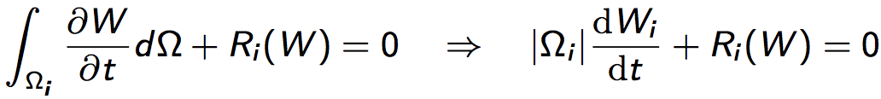
Time stepping: Implicit vs. Explicit
Semi-discrete equations (discretized in space):
Explicit: W computed at current time step
Implicit: W computed at next time step
  Implicit is more stable

Slide 13
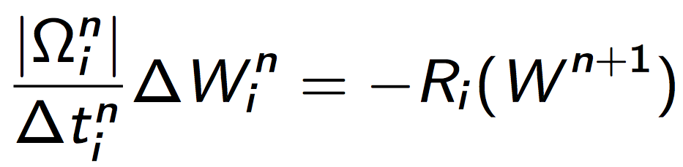
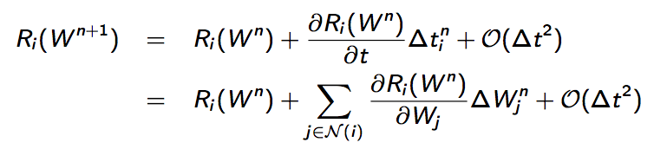
Computing implicit update
Using implicit Euler scheme:
Using Taylor series:
Update to solution
Solution at next time step (unknown)
Solution at current time step
Jacobian

Slide 14
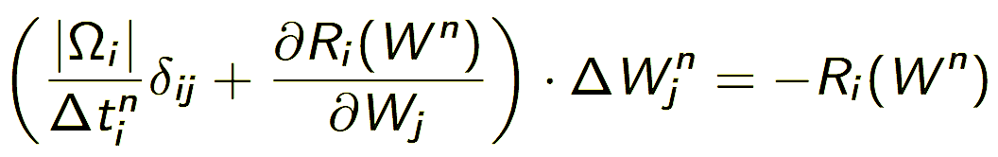
Computing implicit update
Solve for update ΔW
Matrix equation of form Ax=b
Solution strategies:
  FGMRES
  BI-CGSTAB
  Acceleration via Preconditioners
Large, sparse matrix

Slide 15
Lots more to learn!
Multigrid
Boundary conditions
Preconditioners
Monitoring convergence
Adjoint equations
Incompressible solvers
…
Your project here!

